Slide 2

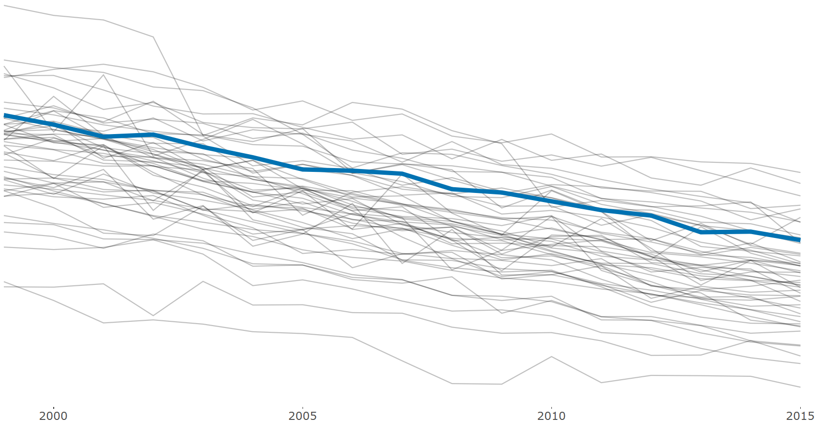
Mortality Rates Related to Cancer are Falling In Every State
Ohio has kept pace with the other states but remains among the top 10 states with the highest rates.
Age-Adjusted Mortalities Per 100,000 Residents
Ohio

